Slide 1


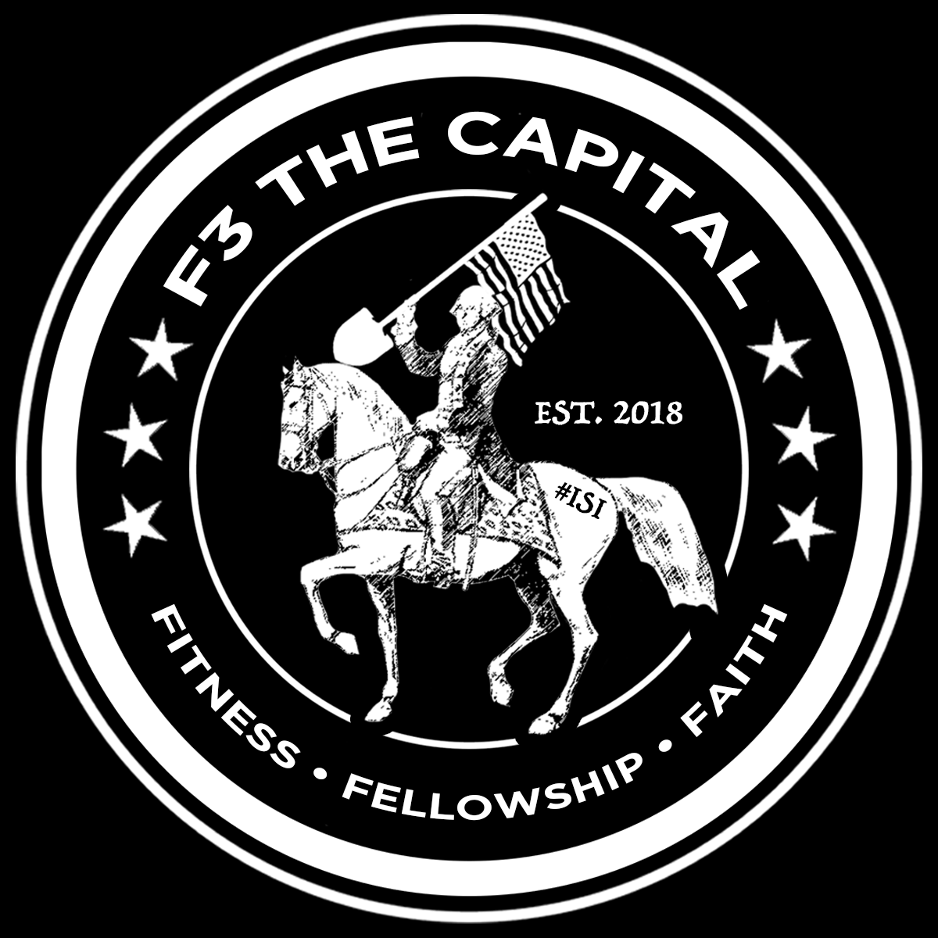
FREE MEN’S BOOTCAMP-STYLE WORKOUTS
F3TheCapital.com
TheCapital@f3nation.com
Change Begins at the End of your Comfort Zone
Get Better, Stronger, Faster!
Fairfax – Springfield – Burke
Weekday Workouts (5:30 – 6:15 am)
Tuesday
Rolling Valley West Park
6512 Sydenstricker Rd, Burke, VA 22015
Wednesday
Luther Jackson Middle School
5 Merrifield Cinema Dr., Fairfax, VA 22031
Thursday
Lake Braddock Secondary School
9200 Burke Lake Rd, Burke, VA 22015
Capital Area Convergence
Weekend Workouts (7 – 8 am)
Saturday
Lake Braddock Secondary School
9200 Burke Lake Rd, Burke, VA 22015
The mission of F³ is to plant, grow, and serve small workout groups for the invigoration of male community leadership.
F³ Five Core Principles All workouts are free of charge. All workouts are open to all men. All workouts are held outdoors – rain or shine, heat or cold Men who participate also lead the workout in a rotating fashion, with no training or certification necessary. All workouts end with a Circle of Trust.
Notes:
5 Merrifield Cinema Dr., Fairfax, VA 22031
9200 Burke Lake Rd, Burke, VA 22015
6512 Sydenstricker Rd, Burke, VA 22015

Slide 2
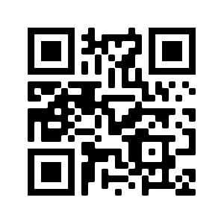
BOOTCAMP-STYLE WORKOUTS
Always Free
Always Outdoors
Open to All Men
Scan Here
F3TheCapital.com
TheCapital@f3nation.com
Notes:
5 Merrifield Cinema Dr., Fairfax, VA 22031
9200 Burke Lake Rd, Burke, VA 22015
6512 Sydenstricker Rd, Burke, VA 22015

